Slide 1
DevOps overview

Slide 2
What is DevOps?
DevOps is a set of practices intended to reduce the time between committing a change to a system and the change being placed into normal production, while ensuring high quality.
DevOps is the practice of operations and development engineers participating together in the entire service lifecycle, from design through the development process to production support.
DevOps is also characterized by operations staff making use many of the same techniques as developers for their systems work.

Slide 3



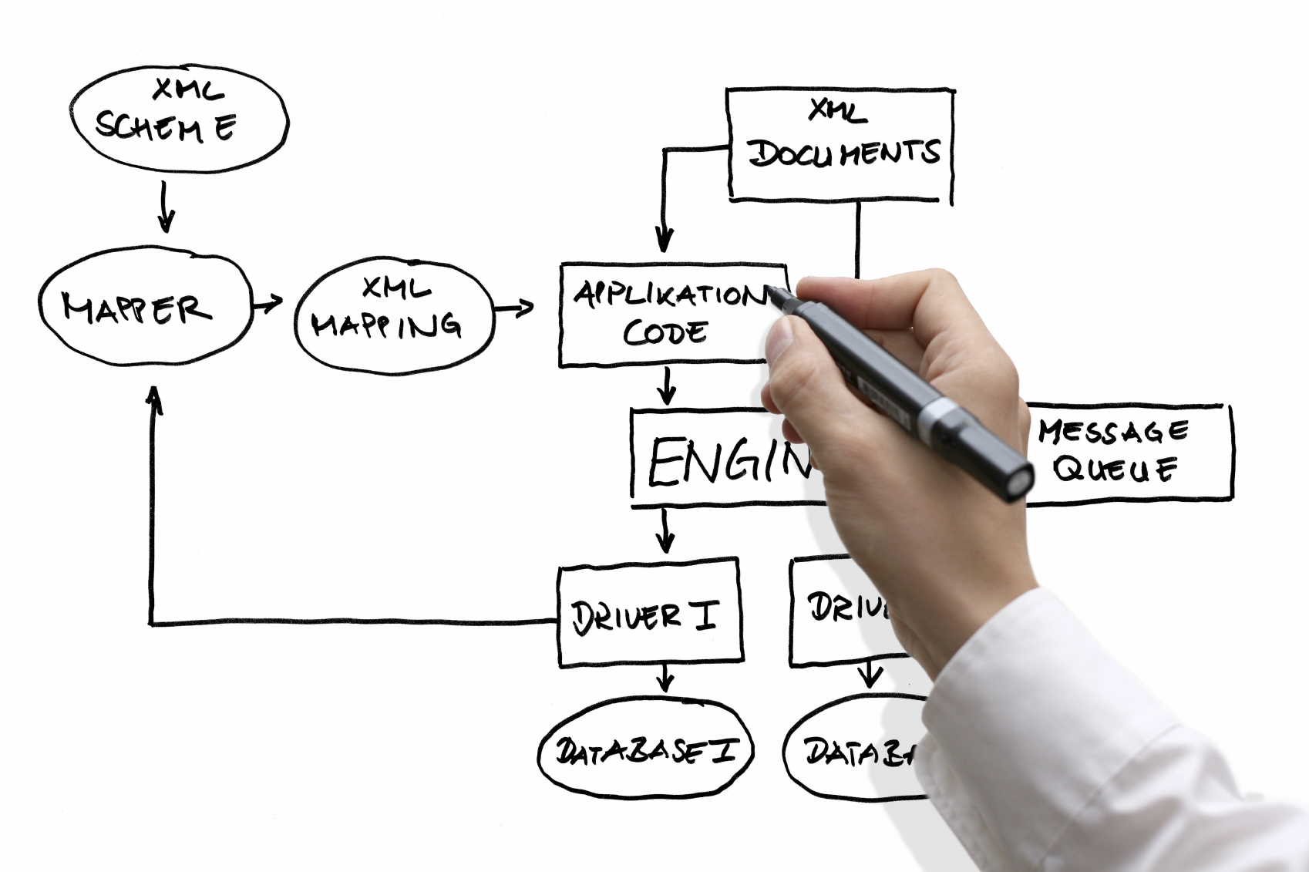
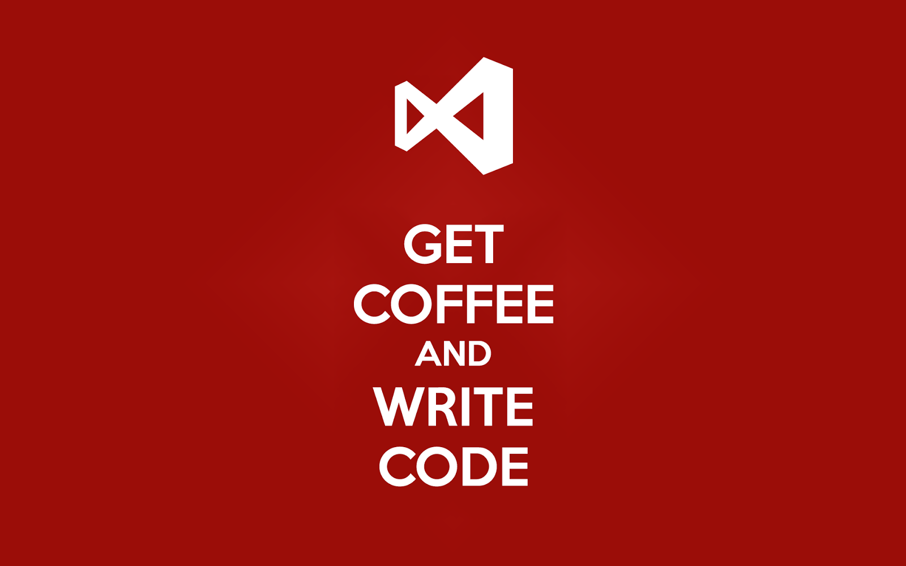

Software Development
Design and specification
Coding
Testing
Release engineering
Evolution
Notes:
Release engineering: how to build the software and deliver it to the final product

Slide 4




Software Operation
Monitoring
Troubleshooting
Capacity planning
Anomaly detection
Q&A
Configuration Tuning

Slide 5
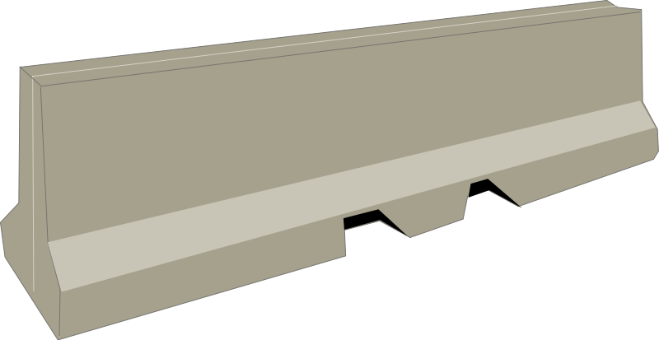
There is a gap between software developers and operators
Does my system perform well in the field?
Developers
What does this error message mean?
How do I resolve it?
Operators

Slide 6
What problem is DevOps trying to solve?
Poor communication between Dev and Ops
Opposing goals
Devs want to push new features
Ops want to keep the system available
→Leads to slower release schedules
Different cultures
Limited capacity of operations staff
Developers have limited insight into operations

Slide 7
Why companies care?
IBM
“IBM has gone from spending about 58% of its development resources on innovation to about 80%”
Paddy Power (Ireland):
“The cycle time from a user story's conception to production has decreased from several months to 2 to 5 days.
“Previously, approximately 30% of the workforce was fixing bugs. Now, bugs are so rare that the teams no longer need a bug-tracking system.”
Notes:
IBM: By removing manual process
Paddy Power is an Irish bookmaker
https://www.youtube.com/watch?v=I9P95PwMIeA

Slide 8
Impact of DevOps at IBM
Overall Time to Development – 55 days to 3 days
52 days faster
Build Verification Test Availability – 18 hours to < 1 hour
17 hours faster
Overall Time to Production – 3 days to 2 days
1 day faster
Time Between Releases – 12 months to 3 months
9 months faster
https://www.ibm.com/developerworks/community/blogs/invisiblethread/entry/ibm_adoption_of_devops_the_journey_within?lang=en

Slide 9
DevOps motivation
Organizations want to reduce time to market for new features, without sacrificing quality
Requires culture change & business-IT alignment
DevOps practices will influence...
the way you organize teams
the way you build systems
even the structure of the systems that you build
Not possible if Devs “throw their final version over the fence” and let operations worry about running it

Slide 10
What does that mean?
High quality code
Testing & test-driven development
High quality builds and delivery mechanism
Automation & more testing
A must when deploying to production 25x per day (etsy.com)
Important time periods:
From commit to before deployment
From deployment until acceptance into production
Testing/close monitoring in production
Notes:
How can we achieve this?

Slide 11
We need automation and tool supports!

Slide 13
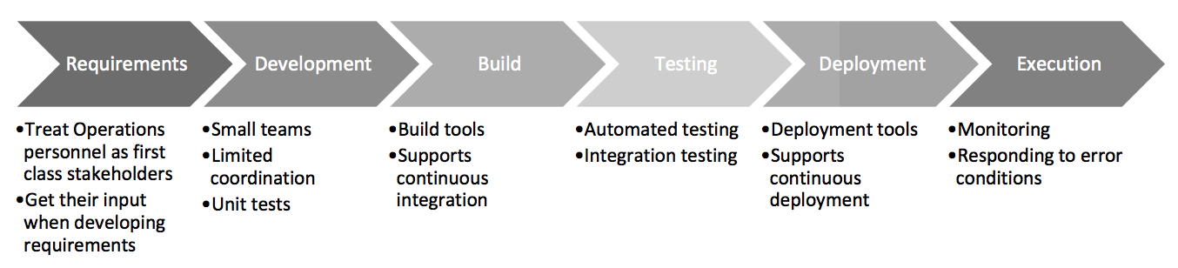
DevOps Practices
Treat Ops as first-class citizens throughout the lifecycle – e.g., in requirements elicitation
Many decisions can make operating a system harder or easier
Logging and monitoring to suit Ops
Make Dev more responsible for relevant incident handling
Shorten the time between finding and repairing errors
Notes:
Mention amazon on-calls
Show Elastic and Kibana
Implications of small teams for software architecture: microservices - DevOps achieves its goals partially by replacing explicit coordination with implicit and often less coordination

Slide 14
DevOps Practices
Automate Everything.
Use continuous deployment,
Commits trigger automatic build, testing, deployment
Enforce deployment process
No ad-hoc deployments
Ensures changes are traceable
Develop infrastructure code with the same set of practices as application code
We need “infrastructure as a code” : using IaaS APIs, etc., to automate creation of environments (Docker)
Misconfiguration can derail your application (Puppet)
Ops scripts are traditionally more ad-hoc
Notes:
Puppet
docker

Slide 15
DevOps Consequences
Architecturally significant requirement:
Speed up deployment through minimizing synchronous coordination among development teams.
Synchronous coordination, like a meeting, adds time since it requires
Ensuring that all parties are available
Ensuring that all parties have the background to make the coordination productive
Following up to decisions made during the meeting

Slide 16
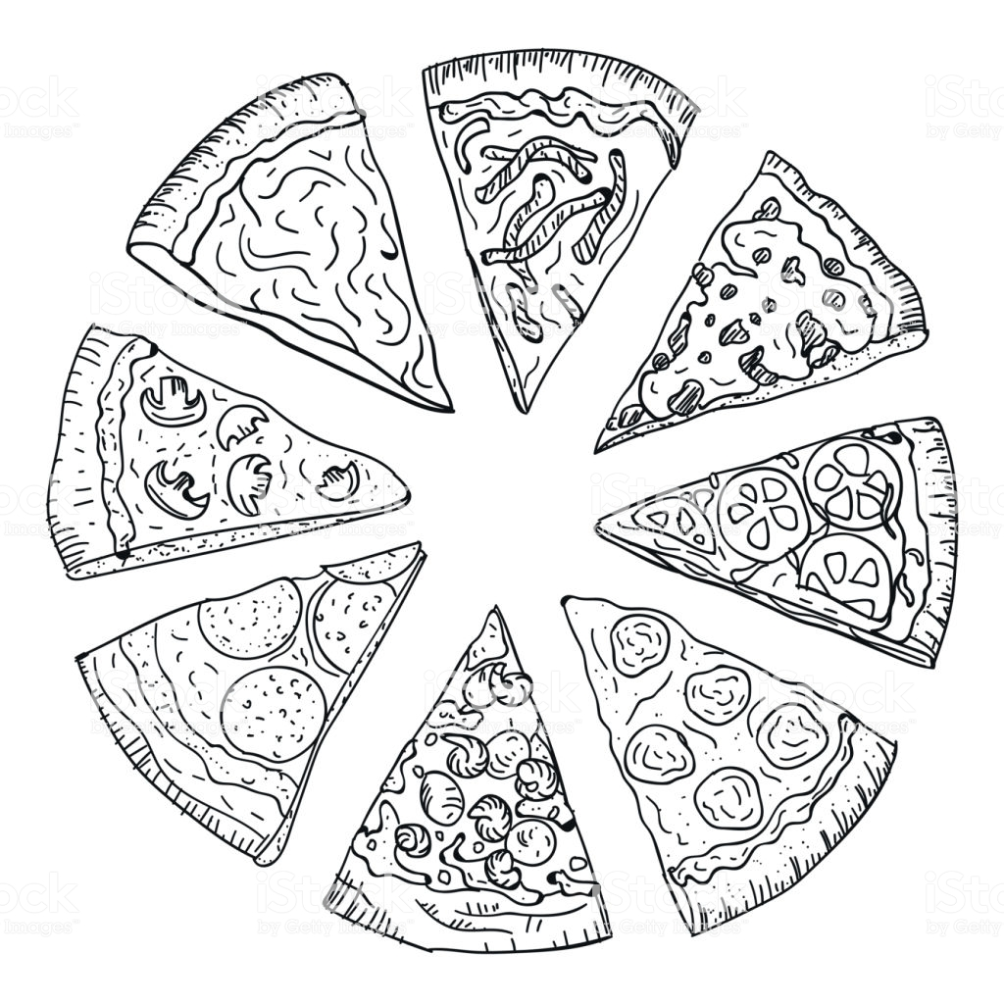
DevOps Consequences
Keep teams relatively small
Amazon’s “two pizza rule”: you should be able to feed the team with two pizzas
Advantages: make decisions quickly, less coordination overhead, more coherent units
Notes:
discourage creative thinking
create a decentralized and innovative workplace environment
Make things faster
http://whatis.techtarget.com/definition/two-pizza-rule

Slide 17
DevOps Consequences
Team size becomes a major driver of the overall architecture:
Small teams develop small services -> Microservices
Coordination overhead is minimized by channeling most interaction through service interfaces:
Team X provides service A, which is used by teams Y and Z
If changes are needed, they are communicated, implemented, and added to the interface.
Notes:
From Wikipedia: It also parallelizes development by enabling small autonomous teams to develop, deploy and scale their respective services independently

Slide 18
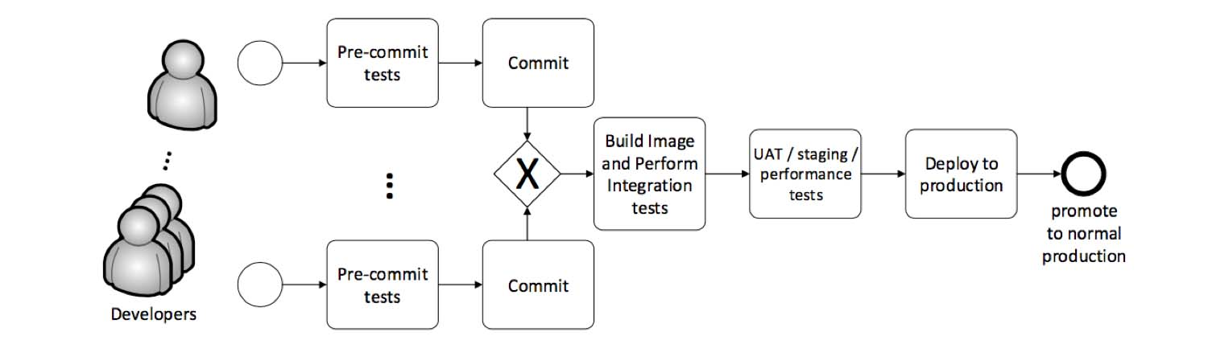
Continuous Deployment Pipeline
Notes:
UAT : user acceptance test

Slide 19
Continuous Deployment Pipeline
Notes:
UAT : user acceptance test

Slide 20
Continuous Deployment Pipeline
Notes:
UAT : user acceptance test

Slide 21
Continuous Deployment Pipeline
Notes:
UAT : user acceptance test

Slide 22
Continuous Deployment Pipeline
Notes:
UAT : user acceptance test

Slide 23
Why test in CI, if you can test on pre-commit ?
Pre-commit and pre-push hooks are great for quick operations and tests.
Unlike unit tests execution time, functional, integration and performance tests often take longer time to run
Also, you want to run your tests in the same environment where you build your deliverables, which is usually not your local machine
Another reason to use CI system is to run post-merge tests to verify that there are no issues introduced by multiple parallel merges.
All-in-all, the more tests you run, the better and a CI system allows you to run both pre-merge tests usually triggered by some sort of pull request hook and post-merge tests in a controlled reliable environment.

Slide 24
Try it out using TravisCI
Set up TravisCI for:
Fork this repository:
https://github.com/peterc-concordia/TravisExercise
Go to https://travis-ci.org/ and log in with your github account
In your profile page, enable Travis’s access to the repo of TravisExercise
On your machine clone your repository
git clone REPLACE_THIS_BY_YOUR_REPO_URL
Add a .travis.yml file to your forked repository
specify the language by putting: language: java
Push a change to break the build (in your forked repo) and see if Travis finds it!
You need to show your CI works and have empty tests available in Sprint 2!
Notes:
https://docs.travis-ci.com/user/tutorial/

Slide 25
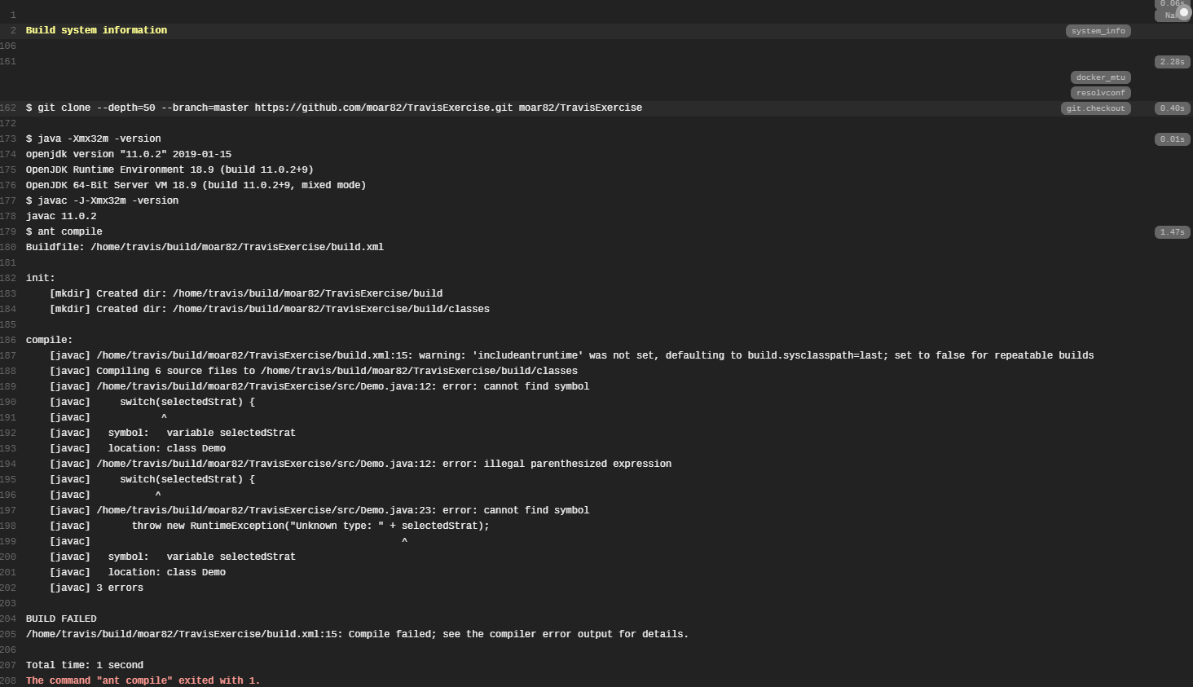
Result

Slide 26
Try it out using TravisCI
Read about how to set up Travis CI for your fork here:
https://travis-ci.org/
http://docs.travis-ci.com/user/getting-started/
http://docs.travis-ci.com/user/languages/java/
http://docs.travis-ci.com/user/languages/java/#Projects-Using-Ant
http://docs.travis-ci.com/user/customizing-the-build/
Add a .travis.yml file to your forked repository
Push a build break into your fork to see if Travis finds it!
Go further: Make your repository based on Maven and use Travis to build and test!

